Slide 1
Charge Route : Building a webapp for range estimation & showing nearest charging station for EV
PIP2001 Capstone Project
Review-0
Batch Number: CST-G10
Roll Number | Student Name
20211CST0056 20211CST0033 20211CST0109 | AANCHAL SAMEER MAIMOONA MAHMOOD T TARA CHANDRA SAI REDDY
Under the Supervision of,
Prof. Radhika Sreedharan
Professor
School of Computer Science and Engineering
Presidency University
Name of the Program: B.Tech - CST AIML
Name of the HoD: Dr. Saira Banu
Name of the Program Project Coordinator: Dr. Manjula H M
Name of the School Project Coordinators: Dr. Sampath A K / Dr. Abdul Khadar A / Mr. Md Ziaur Rahman

Slide 2
Content
Problem Statement
Github Link
Analysis of Problem Statement
Timeline of the Project
References

Slide 3
Problem Statement
Category : Software
Problem Description: Charge Route:Owners of electric vehicles (EVs) can use this web application to locate EV charging outlets in the area and estimate the range of their vehicle. It displays charging stations in close proximity and performs location searches using the Google Maps API.
Difficulty Level: Complex

Slide 4
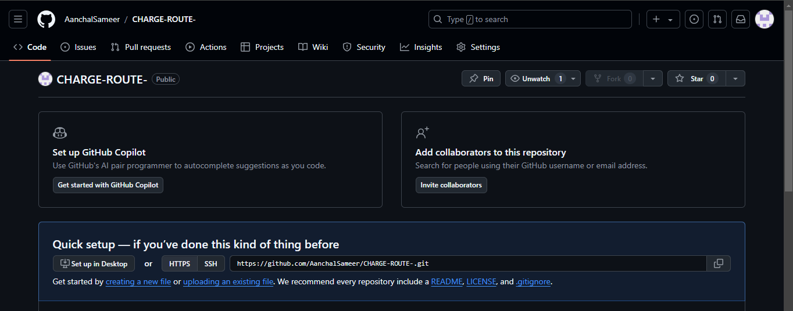
Github Link
https://github.com/AanchalSameer/CHARGE-ROUTE-

Slide 5
Analysis of Problem Statement
Technology Stack Components:
Frontend:
React : A JavaScript library for building user interfaces. It manages the state and rendering of the components.
Google Maps API : Provides map functionalities, including location autocomplete and places search.
Backend:
Node.js & Express : Handles server-side logic, API requests, and integration with other services. This is relevant if you have a backend to handle additional features or API calls.

Slide 6
Analysis of Problem Statement
Working of project
Stage 1: Project Setup
Installation of React and Node.js
Stage 2: UI Design/React
Stage 3: Google Maps API Integration
Configuring the Google Maps API by obtaining an API key from Google Cloud
Stage 4: Range Estimation Algorithm
Implementing logic in React to calculate the range based on the input

Slide 7
Analysis of Problem Statement
Stage 5: Display Nearest Charging Stations
Once the user’s range is calculated, display nearby charging stations within that range on the map.
Stage 6: Routing and Directions
Use Google Maps Directions API to provide navigation from the user’s current location to the selected charging station and route optimization for multiple charging stations if needed.
Stage 7: Optimization & Testing
Improve UI/UX for displaying charging stations and testing for various scenario, devices.

Slide 8
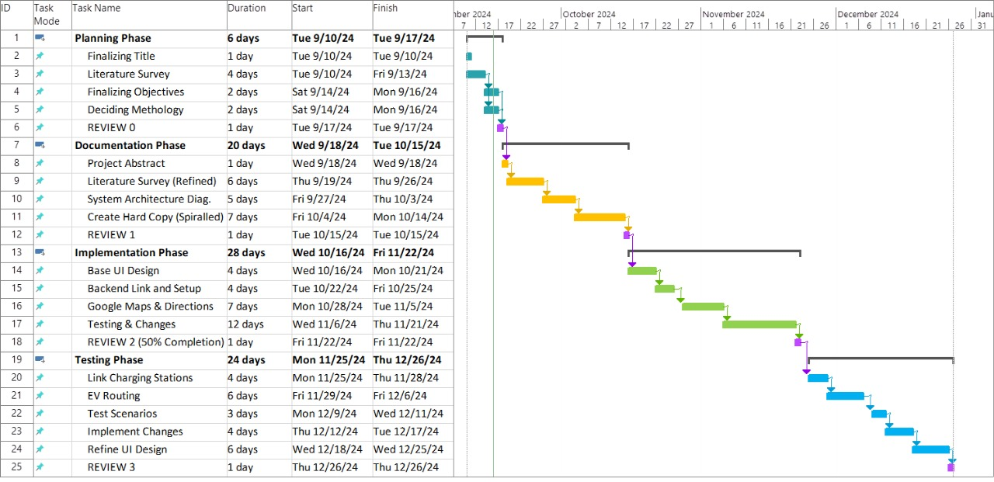
Timeline of the Project (Gantt Chart)

Slide 9
References (IEEE Paper format)
Tiwary, A., Mishra, S., & Kumar, U. (2024). Electric vehicle range estimation based on driving behaviour employing long short-term memory neural network. 2024 International Symposium on Power Electronics, Electrical Drives, Automation and Motion (SPEEDAM), 551-555. https://doi.org/10.1109/SPEEDAM61530.2024.10609085
Shekhar, A., Prasanth, V., Bauer, P., & Bolech, M. (2015). Generic methodology for driving range estimation of electric vehicle with on-road charging. 2015 IEEE Transportation Electrification Conference and Expo (ITEC), 1-8. https://doi.org/10.1109/ITEC.2015.7165763
Sağlam, B., Bostancı, E., & Göl, M. (2021). Parameter estimation of electric vehicles for improved range prediction. 2021 IEEE PES Innovative Smart Grid Technologies Europe (ISGT Europe), 1-5. https://doi.org/10.1109/ISGTEurope52324.2021.9640048

Slide 10


